Slide 1


Python for HWRF Training
Christina Holt – DTC, ESRL/GSD, CIRES
Samuel Trahan – NOAA/EMC, IMSG

Slide 2
Motivation & Goals
HWRF Developers have expressed a need for more specific training using the Python scripts implemented in operations in 2015
HWRF is a very complex system that keeps growing in complexity
As research and development continues to be funded and required developers have a greater need to know the details of the complex scripting system

Slide 3
Agenda
9:00 | HWRF System Overview | Christina
9:30 | HWRF Internals Overview | Sam
9:50 | Object-oriented Scripts | Christina
10:10 | Produtil & Data Delivery | Sam
10:40 | ~*~* Break *~*~
11:00 | Logs Overview | Christina
11:20 | Troubleshooting | Sam
11:50 | Configuring | Sam
12:30 | ~*~* Lunch *~*~
1:30 | Rocoto for HWRF | Christina
2:00 | Database | Sam
2:30 | Debugging | Christina
3:00 | ~*~* Break *~*~
3:30-5:00 | Adding a Workflow Component | Christina & Sam

Slide 4
Resources for users and developers
Documentation
Developer webpage
Developer committee meetings and mailing list
Doxygen

Slide 5
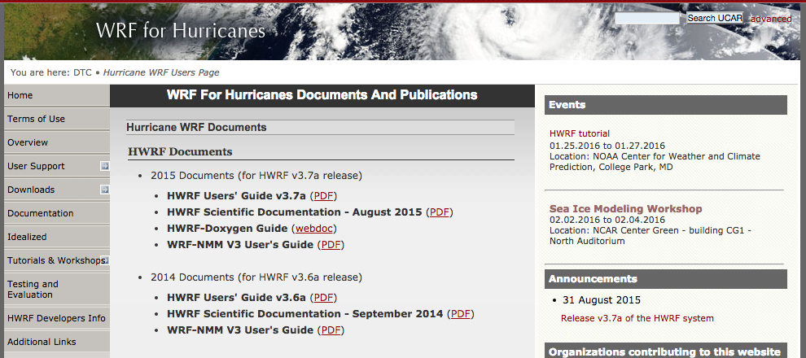
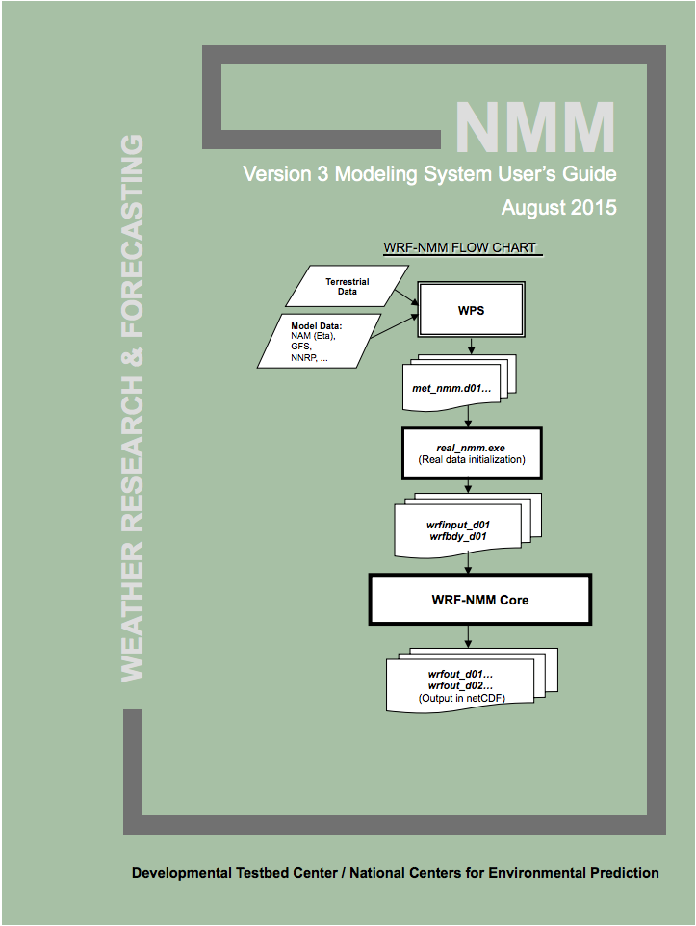
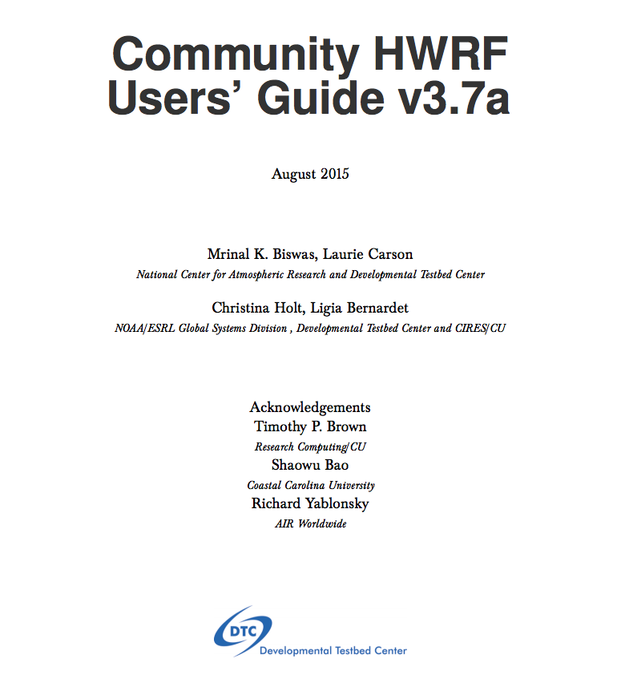
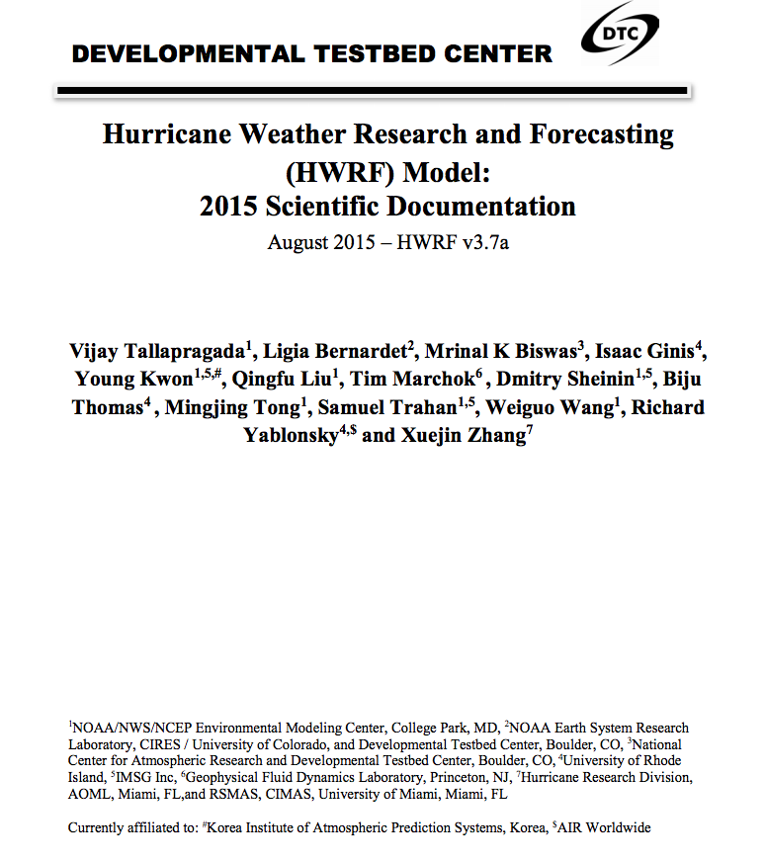
User support webpage
www.dtcenter.org/HurrWRF/users

Slide 6
Scientific Documentation
Technical information covering each HWRF component
Authorship includes developers and experts
Chapters covering:
HWRF introduction
HWRF Initialization
MPI POM-TC
Physics Packages in HWRF
Design of moving nest
Use of GFDL Vortex Tracker
The idealized HWRF framework
http://www.dtcenter.org/HurrWRF/users/docs/scientific_documents/HWRF_v3.7a_SD.pdf

Slide 7
HWRF v3.7a User’s Guide
Includes detailed instructions on running each component
Geared towards public release, so some aspects will be missing
Running with wrappers, no Rocoto information
Content:
Introduction & software installation
Running HWRF
HWRF preprocessing system
Vortex Relocation
DA
Merge
MPIPOM-TC
Forecast Model
Post processor
Forecast products
Idealized
http://www.dtcenter.org/HurrWRF/users/docs/users_guide/HWRF_v3.7a_UG.pdf

Slide 8
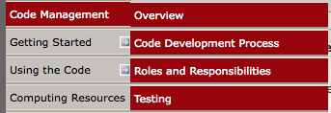
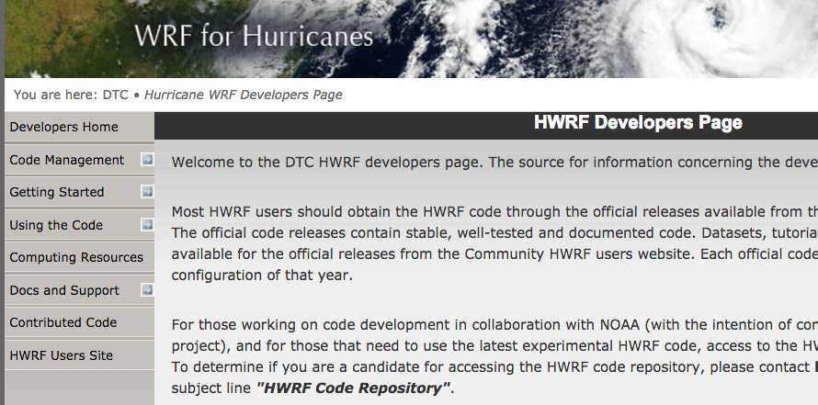
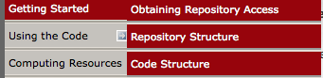
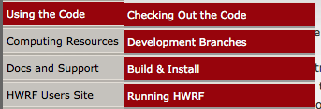
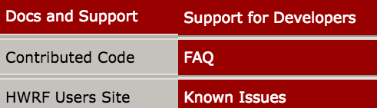
HWRF Developers Website
http://www.dtcenter.org/HurrWRF/developers
Information hub for all developers
Trainings offered by DTC:
HWRF automation with the Rocoto workflow management system
HWRF code management

Slide 9
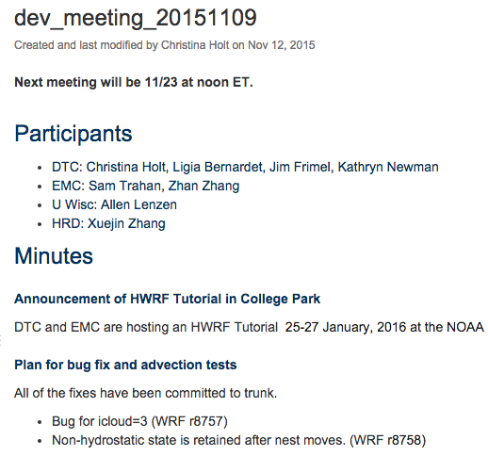
Communications
HWRF Developers Committee
All developers welcome to attend biweekly meetings
Forum for discussion, plans, and updates for development, including testing, evaluation, and technical aspects
Mailing list for exchanging information about development
hwrf_developers@rap.ucar.edu
All those with HWRF repository access are members

Slide 10
Doxygen Website

Slide 11
General Python help
Online (https://docs.python.org/release/2.6.6/)
Open python in a terminal and use help() function for particular function. An example to get information with a Python list:
$ python
$ help(list)
Must use Python v2.6.6.
Only version available on NOAA machines
2.7 may be used in future because it's the long-term support release
Version 3 is basically a different language

Slide 12
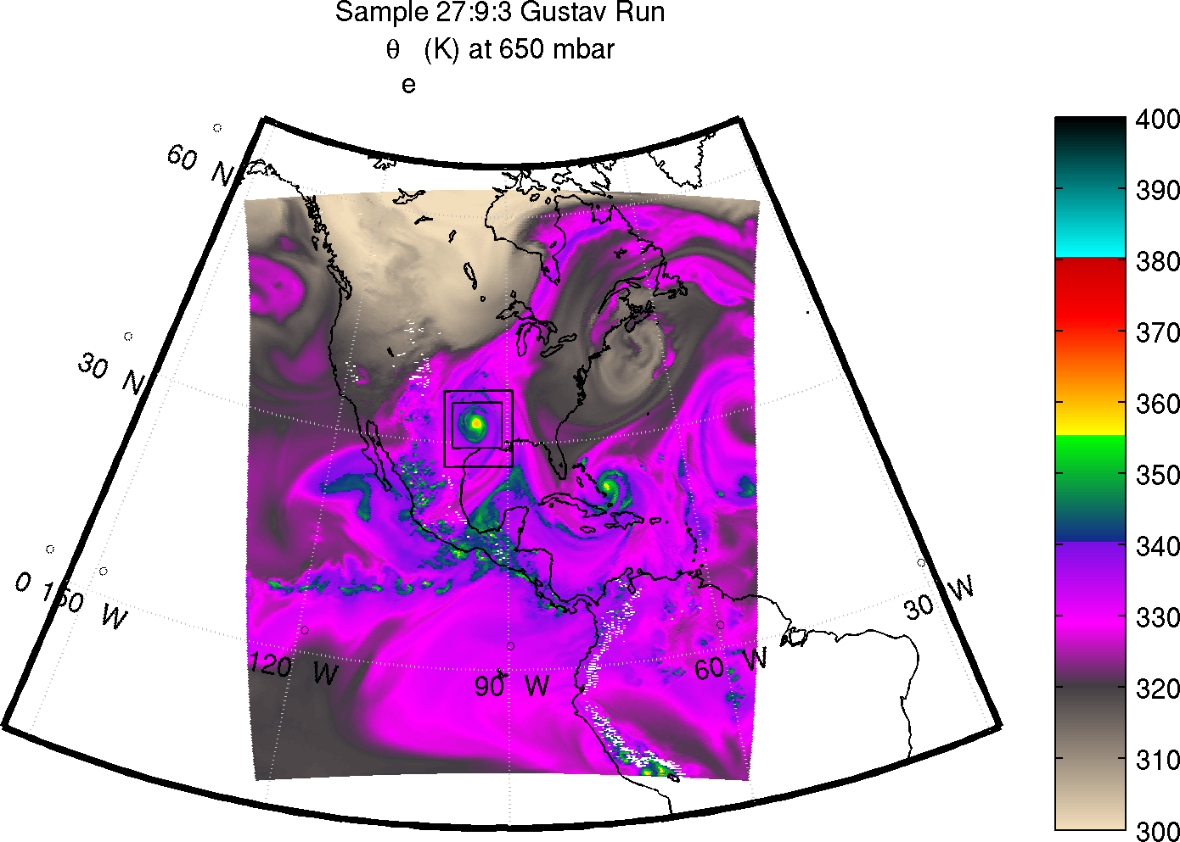
HWRF System Overview
Overview of the system design
Jobs of each task
Common configurations and available capabilities

Slide 13
HWRF System: Overview
6 layers of scripts that are responsible for preparing for and running the 118 (for now) HWRF executables of the end-to-end system
Most of these layers are written using an object-oriented (O-O) Python design
O-O design makes the system highly configurable and reduces the footprint of the system drastically

Slide 14
HWRF System: Intercycle Layer
Handles interactions between several cycles
Complex dependencies
Files passed between them
Archiving
Scrubbing
Workflow automation takes care of these items
Not needed for a case study
Critical for a large retrospective study, and for real-time automation

Slide 15
HWRF System: Workflow Layer
Splits work into multiple batch jobs
Handles dependencies, submission, failures, and resubmission of jobs

Slide 16
HWRF System: Scripting Layer
Loads programs and libraries into computing environment
Ensures connection to file system on compute node
Passes file and executable locations to the next lower layer
Layer is optional – can be done manually by user

Slide 17
HWRF System: Experiment Layer
Describes the HWRF workflow
Creates the object structure that connects all the pieces
i.e. GSI should use input from the GDAS relocation output
Each object has a run() function to perform the actual task

Slide 18
HWRF System: Implementation Layer
A set of Python classes and functions used by the Experiment layer to run HWRF
Each component has its own class and set of functions
Some classes perform utilities to support the system, such as predicting filenames and performing time/date arithmetic
Includes two packages
pom – Princeton Ocean Model initialization
hwrf – Implementation of most of the HWRF system

Slide 19
HWRF System: Portability Layer
Implements cross-platform methods of performing common tasks
MPI implementation
OpenMP
Serial programs
File operations
Batch system interaction
Manipulate resource limitations
Interact with database file

Slide 20
HWRF Tasks
Ensemble forecast was started from the GFS ensemble of the previous cycle when TDR is available
GFS ensemble is used for hybrid DA when TDR is not available
Descriptions of each task are available from the Doxygen documentation
Each box has its own set of jobs (Rocoto, ecFlow, wrappers to some extent), scripts, and Python classes
http://www.emc.ncep.noaa.gov/HWRF/scripts/index.html

Slide 21
HWRF Default Configurations
2016 Defaults
2015 Defaults
hwrf_AL.conf (empty)

Slide 22
HWRF Workflow: AL or EP w/TDR

Slide 23
HWRF Workflow: Atlantic w/o TDR
Data assimilation is performed with ensemble covariances provided by the global ensemble

Slide 24
HWRF Workflow: EP w/o TDR
No data assimilation is performed when TDR is unavailable

Slide 25
HWRF Workflow: All other basins
No data assimilation or ocean coupling in other basins.
Lower vertical resolution is also used for forecast

Slide 26
Other Available Configurations
Full system in all basins
27:9:3 resolution
Lower vertical structure (Lower model top & 43 vertical levels)
GEFS-based HWRF ensemble
Different forecast length (6 hrly from 12 – 126 hours)
Physics schemes
Scale-aware SAS, GFS PBL with EDMF, SAS, Thompson microphysics
Disable select components
GSI, DA Ensemble, Ocean Coupling, Initialization
Run without spectral files
Multistorm capability
For information on running these additional configurations, visit:
http://www.emc.ncep.noaa.gov/HWRF/scripts/available_configurations.html

Slide 27
Questions?
Next up….
HWRF Internals Overview

Slide 28
Extras

Slide 29
HWRF Tasks: AL Default w/o TDR

Slide 30
HWRF Tasks: EP Default w/o TDR

Slide 31
HWRF Tasks: Other basins

